Slide 1


Slide 4
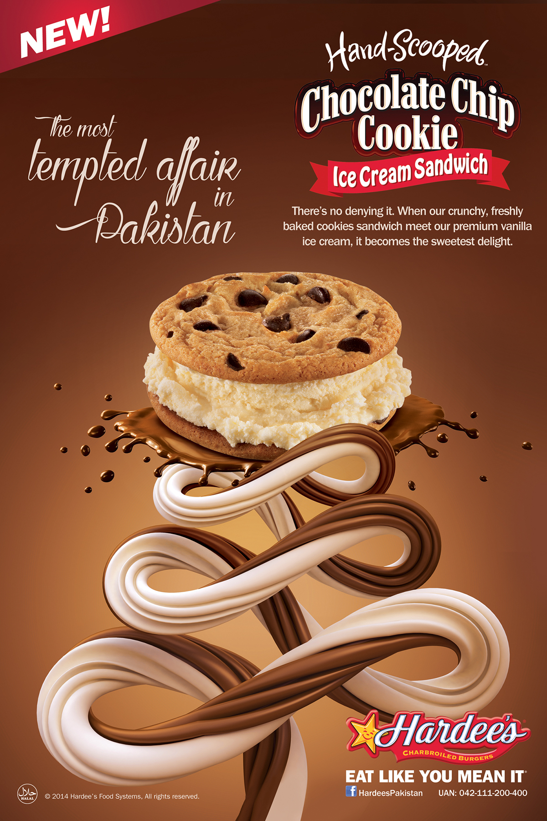



Slide 8
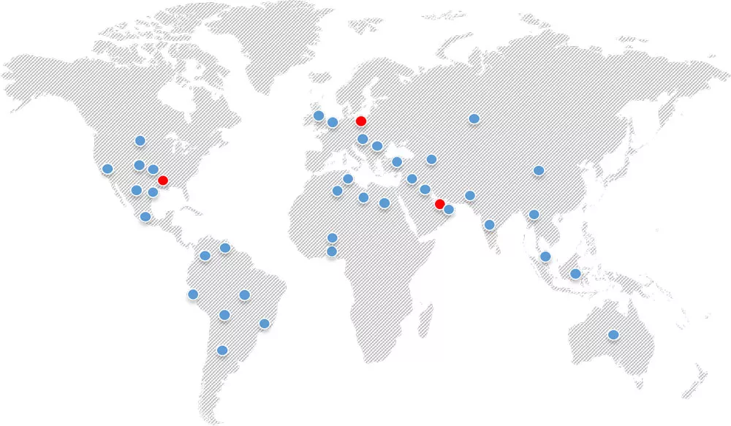

Slide 11
yummy in every bite!

Slide 12
Every bite is oh yummy

Slide 13
Cookie makes everything better

